Slide 1
Image Compression

Slide 2
Compression means
Reduction in Size, in bytes of an Image File, without degrading the quality of the Image.
Why we do Image Compression
We do compression
As it allows more Images in an given amount of Memory Space.
To allow more files to Transfer through Internet using less bandwidth & less time.
eg: Images we send through WhatsApp are compressed before sending.

Slide 3
What is Image Compression
Image compression is,
The art and science of reducing the amount of data required to represent an image.
It is one of the most useful and commercially successful technologies in the ﬁeld of digital image processing.
The number of images that are compressed and decompressed daily is called staggering.
The compressions and decompressions themselves are virtually invisible to the user.
Any one who uses a digital camera, surfs the web or watches movies on DVD’s benefits from I.C. algorithms & standards.

Slide 4
eg: The amount of data required to represent an image for a standard definition (SD) tv movie uses 720 x 480 x 24 bit pixel arrays, with 30 fps ( frames per second)
SD digital video data must be accessed at
30frames x (720x480)pixels x 3Bytes
sec frame pixel
= 31,104,000 bytes / sec
and a two - hour movie consist of
31,104,000 bytes / sec x (60²) sec /hr x 2 hrs
≈ 2. 24 x 10¹¹ bytes or 224 GB of data
This is huge data, Therefore Compression is necessary.

Slide 5
Even through web page image is high resolution, digital cameras photos also compressed routenely to save storage space & reduce transmission time.

Slide 6
The term data compression refers to the process of reducing the amount of data required to represent a given quantity of information.
Data contains irrelevant or repeated information are said to contain redundant data.
If we let b and b1 denote the number of bits (or information- carrying units) in two representations of the same information, the relative data redundancy, R, of the representation with b bits is
R = 1 - 1/C
where C, commonly called the compression ratio, is defined as
C = b/b1

Slide 7
If C = 10 (sometimes written 10:1), for instance, the larger representation has 10 bits of data for every 1 bit of data in the smaller representation.
The corresponding relative data redundancy of the larger representation is 0.9 (R = 0.9), indicating that 90% of its data is redundant.

Slide 8
Any kind of data can be compressed. There are two main types of compression: lossy and lossless.
Lossy compression
Lossy compression removes some of a file’s original data in order to reduce the file size.
This might mean reducing the numbers of colours in an image or reducing the number of samples in a sound file.
This can result in a small loss of quality of an image or sound file.
eg: JPEG- lossy compression method for images.
MP3-lossy compression method for sounds.
MPEG- for videos
Note: Once a file has been compressed using lossy compression, the discarded data cannot be retrieved again.

Slide 9
Lossless compression
It doesn’t reduce the quality of the file at all.
No data is lost, so lossless compression allows a file to be recreated exactly as it was when originally created.
eg: Zip files are an example of lossless compression.
Run length encoding
Huffman coding

Slide 10
Our eyes can’t distinguish small changes, so lossy data is acceptable.
Decompression: is the reverse process, where the redundant parts put back into representation to restore and put in original form.

Slide 11
three principal types of data redundancies
Coding redundancy.
Spatial and temporal redundancy.
Irrelevant information
Coding redundancy.
A code is a system of symbols (letters, numbers, bits, and the like) used to represent a body of information or set of events.
Each piece of information or event is assigned a sequence of code symbols, called a code word.
The number of symbols in each code word is its length.
The 8-bit codes that are used to represent the intensities in most 2-D intensity arrays contain more bits than are needed to represent the intensities.

Slide 12
Spatial and temporal redundancy.
Repeated information is present in image plane itself
and
temporal information is present in image plane itself with time.
Because the pixels of most 2-D intensity arrays are correlated spatially (i.e., each pixel is similar to or dependent upon neighboring pixels)
information is unnecessarily replicated in the representa- tions of the correlated pixels.
In a video sequence, temporally correlated pixels (i.e., those similar to or dependent upon pixels in nearby frames) also duplicate information.

Slide 13
Irrelevant information
Irrelevant repeated information is present, which is compressed.
Most 2-D intensity arrays contain information that is ignored by the human visual system and/or extraneous to the intended use of the image.
It is redundant in the sense that it is not used.

Slide 14
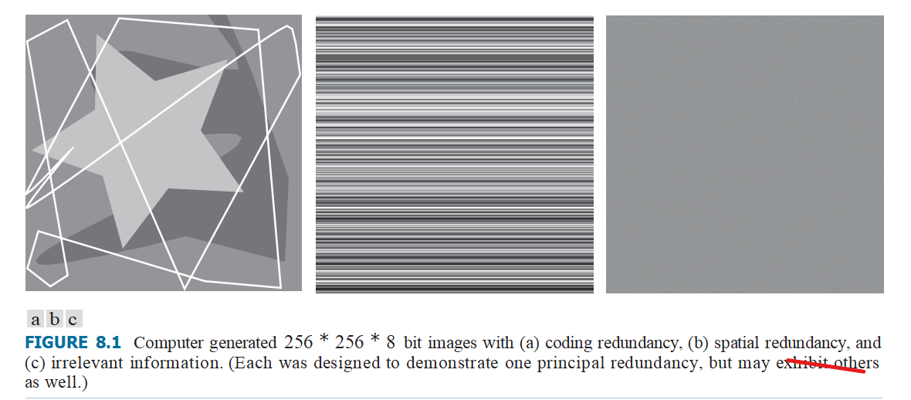
Coding Redundancy

Slide 15


Coding redundancy
rk: a discrete random variable, in interval [0,L- 1]
-is used to represent the intensities of an M * N image, and that each rk occurs with probability pr(rk ).
L -no.of intensity values
nk -no.of times kth intensity appears in the image
the no.of bits used to represent each value of rk is l(rk ),
then the average number of bits required to represent each pixel is
r_{k} | p_{r}(r_{k}) | Code1 | l₁(r_{k}) | Code2 | l₂(r_{k})
r₈₇=87 | 0.25 | 01010111 | 8 | 01 | 2
r₁₂₈=128 | 0.47 | 01010111 | 8 | 1 | 1
r₁₈₆=186 | 0.25 | 01010111 | 8 | 000 | 3
r₂₅₅=255 | 0.03 | 01010111 | 8 | 001 | 3
r_{k}fork=87,128,186,255 | 0 | — | 8 | — | 0

Slide 16
The total number of bits required to represent an
M * N image is : MNLavg.
the average length of the encoded pixels is,
Lavg = 0.25(2) + 0.47(1) +0.25(2)+ 0.03(3)=1.81 bits
The total number of bits needed to represent the entire image is
MNLavg = 256 * 256 * 1.81, or 118,621.
the resulting compression and corresponding relative redundancy are
C = 256×256×8 = 8 ≈4.42
118,621 1.81
and R= 1- 1 = 0.774
4.42
Thus 77.4% of data in original 8-bit 2-D array is redundant.

Slide 17
SPATIAL AND TEMPORAL REDUNDANCY
1.All 256 intensities are equally probable. As Fig. 8.2 shows, the histogram of the image is uniform.
2.Because the intensity of each line was selected randomly, its pixels are independent of one another in the vertical direction.
3.Because the pixels along each line are identical, they are maximally correlated (completely dependent on one another) in the horizontal direction.

Slide 18
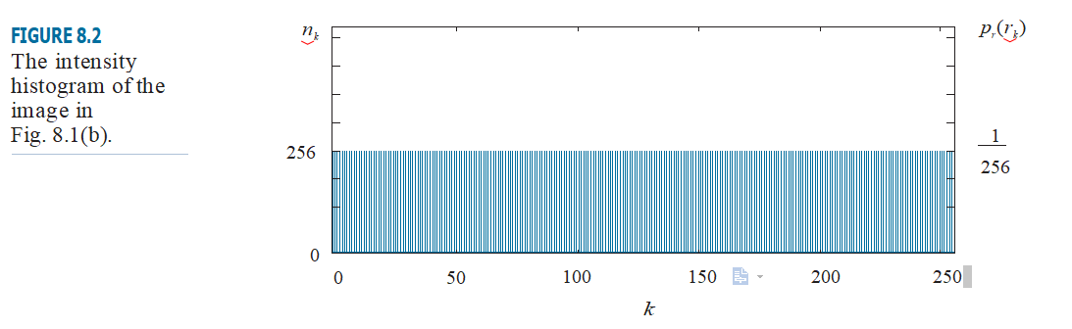

Slide 19
IRRELEVANT INFORMATION
One of the simplest ways to compress a set of data is to remove superfluous data from the set.
In the context of digital image compression, information that is ignored by the human visual system, or is extraneous to the intended use of an image, are obvious candidates for omission.
Thus, the computer-generated image in Fig. 8.1(c), because it appears to be a homogeneous field of gray, can be represented by its average intensity alone—a single 8-bit value.
The original 256 * 256 * 8 bit intensity array is reduced to a single byte, and the resulting compression is (256 * 256 * 8) 8 or 65,536:1. Of course, the original 256 * 256 * 8 bit image must be recreated to view and/or analyze it, but there would be little or no perceived decrease in reconstructed image quality.

Slide 20
MEASURING IMAGE INFORMATION
the generation of information can be modeled as a probabilistic process which can be measured in a manner that agrees with intuition.
In accordance with this supposition, a random event E with probability P(E) is said to contain
I(E) = log(1 / P(E))= - log P(E)
units of information. If P(E) = 1 (that is, the event always occurs), I(E) = 0 and no information is attributed to it.

Slide 21

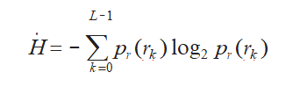
Given a source of statistically independent random events from a discrete set of possible events a1, a2,.. aJ ☒ with associated probabilities P(a1), P(a2),.. P(aJ ),
the average information per source output, called the entropy of the source, is
the intensity source’s entropy becomes

Slide 22
Shannon’s first theorm
It represents intensities of an image.
It is higher than 1.6614 bits/pixel entropy estimate from Shannon also called Noiseless coding theorm.
It represents
n -source symbols with single code word.
lim
n-->∞[Lavg,n] =H
n
Lavg,n-- avg no.of code symbols needed to represent all n-symbol groups.

Slide 23
Fidelity Criteria
These criteria are used to measure image fidelity.
They quantify the nature and extent of information loss in image compression.
Fidelity criteria can be divided into classes:
1.Objective fidelity criteria-Information loss
2.Subjective fidelity criteria-Human observe Image Quality

Slide 24
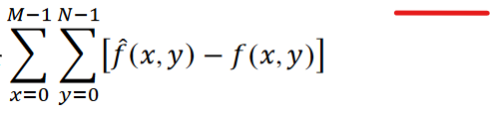
Objective fidelity criteria
used to measure the amount of information loss (i.e. error) in the reconstructed (decompressed) image.
e(x,y) = f^(x,y) - f(x,y)
Commonly used objective fidelity criteria include:
Total Error B/w 2 imgs is

Slide 25
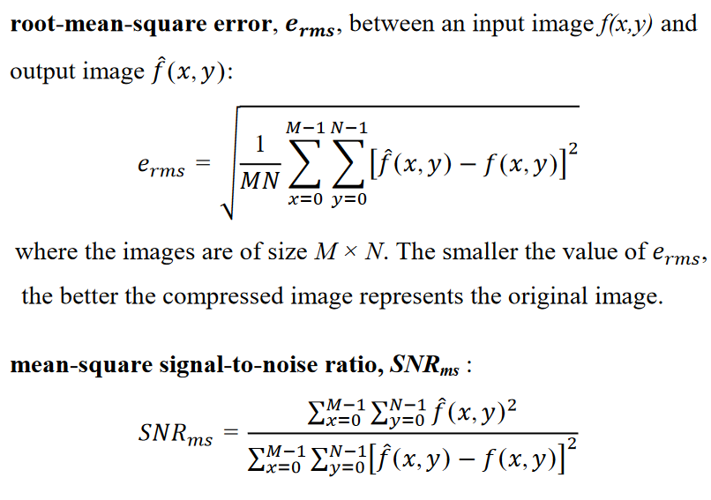

Slide 26
Subjective fidelity criteria
Human observer measure image quality.
By showing a decompressed image to a group of viewers and averaging their evaluations.
The evaluations may be made using an absolute rating scale.
eg: {Excellent, Fine, Passable, Marginal, Inferior, and Unusable}.

Slide 27
Image Compression Model
Reducing amount of data in Size, in bytes of an Image File, without degrading the quality of the Image.
Image Compression system is composed of 2 functional components
Encoder - performs compression
Decoder - performs decompression.
Both operations are performed in
S/W application : Web browsers
H/W devices : DVD players

Slide 28
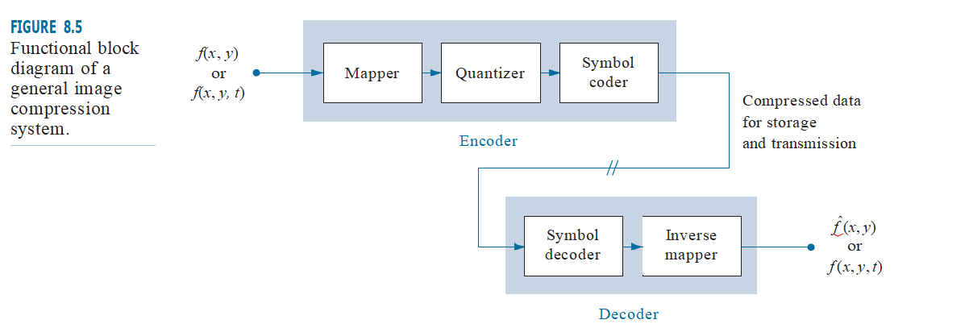
IMAGE COMPRESSION MODELS
A codec is a device or program that is capable of both encoding and decoding.
Encoder : is responsible for reducing or eliminating any coding, Spatial & Temporal (interpixel), or Irrelavent (psychovisual) redundancies in the input image.

Slide 29
they are f (x, y, t) and fˆ(x, y, t), where the discrete parameter t speciﬁes time.
fˆ(x, y,t) may or may not be an exact replica of f (x, p).
If it is, the compression system is called error free, lossless, or information preserving.
If not, the reconstructed output image is distorted, and the compression system is referred to as lossy.

Slide 30
mapper: transforms f (x, y) into format designed to reduce spatial and temporal redundancy.
It is reversible, and may or may not directly reduce the amount of data required to represent the image.
Eg: Run-length coding.
In video applications, the mapper uses video frames to facilitate the removal of temporal redundancy.

Slide 31
quantizer: reduces the accuracy of the mapper’s output in accordance with a preestablished ﬁdelity criterion.
The goal is to keep irrelevant information out of the compressed representation.
this operation is irreversible.
In video applications, the bit rate of the encoded output is often measured (in bits/second), and is used to adjust the operation of the quantizer so a predetermined average output rate is maintained.
Thus, the visual quality of the output can vary from frame to frame as a function of image content.

Slide 32
symbol coder:
It creates a fixed or variable length code to represent the quantizer output.
In this shortest code words are assigned to the most frequently occurring output values.
And thus reduce coding redundancy.
This operation is reversible.
Its completion, the input image has been processed for the removal of each of the three redundancies described.

Slide 33
Decoder:
It contains only 2 components:
symbol decoder
An inverse mapper
It perform reverse operation.
In video applications,
Decoded output frames are maintained in an internal frame store.
It used to reinsert the Temporal redundancy that was removed at the encoder.

Slide 34
Image Compression Methods
1)Huffman Coding
is a popular technique for removing coding redundancy.
The result after Huffman coding is variable length code, where the code words are unequal length.
Huffman coding yields the smallest possible number of bits per gray level value.

Slide 35
Huffman coding yields the smallest possible number of code symbols per source symbol.
step1)
create a series of source reductions by ordering the probabulities of the symbols under consideration and combining the lowest probabulities of the symbols into a single symbol that replaces them in the next source reduction.
This process is then repeated until a reduced source with 2 sym bols is reached.

Slide 36
step2)
to code each reduced source, starting with the smallest source and working back to the original source.

Slide 37
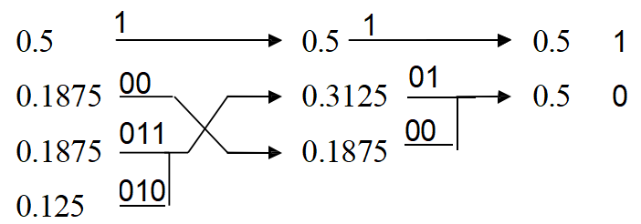
Consider the 8-bit gray image shown below. Use Huffman coding technique for eliminating coding redundancy in this image.
119 | 123 | 168 | 119
123 | 119 | 168 | 168
119 | 119 | 107 | 119
107 | 107 | 119 | 119
Solution:
Graylevel | Histogram | Probability
119 | 8 | 0.5
168 | 3 | 0.1875
107 | 3 | 0.1875
123 | 2 | 0.125

Slide 38
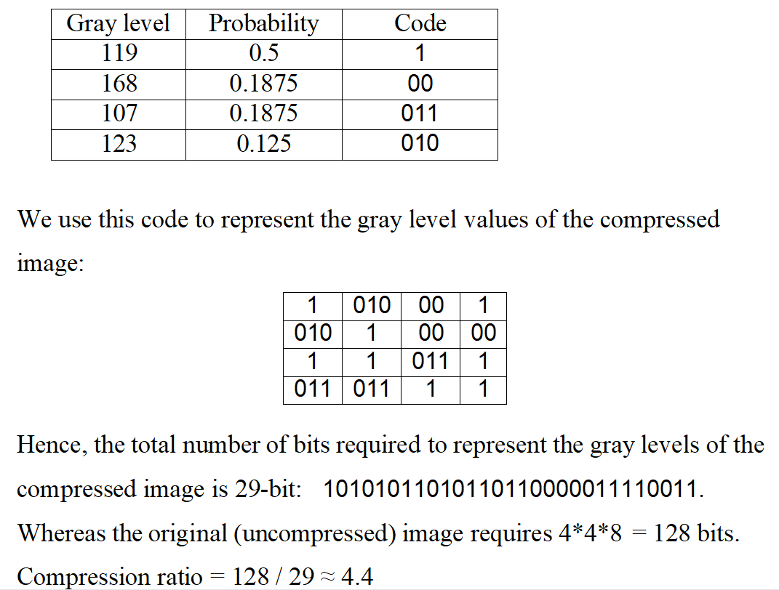
Lavg=0.5*1 + 0.1875*2 + 0.1875*3 + 0.125*3=1.8125 bits/pixel

Slide 39
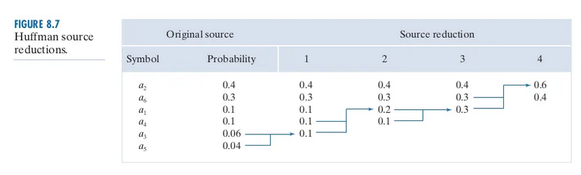

Slide 40
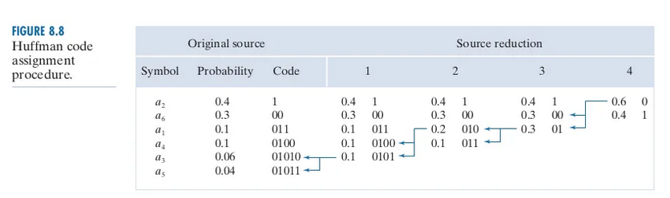
The average length of this code is
Lavg= 0.4*1 + 0.3*2 + 0.1*3 + 0.1*4 + 0.06*5 + 0.04*5 = 2.2 bits/pixel

Slide 41
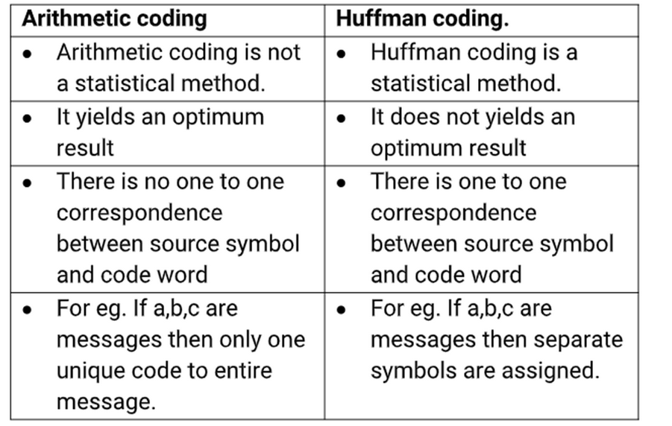

Slide 42
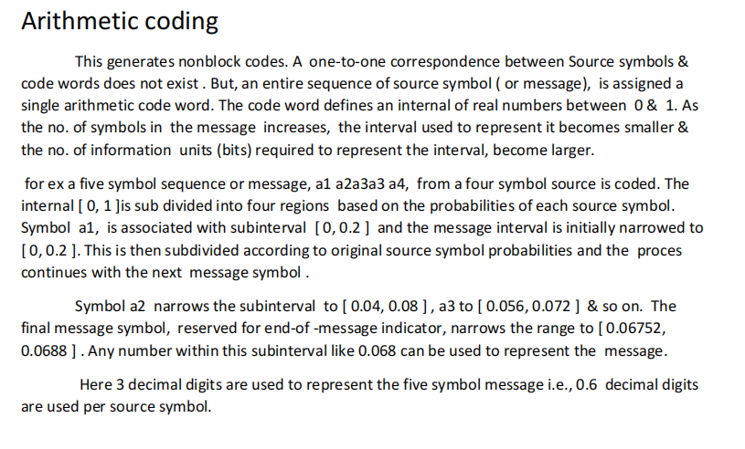

Slide 43
